Slide 1
PowerPoint Demo
December 16, 2019

Slide 2
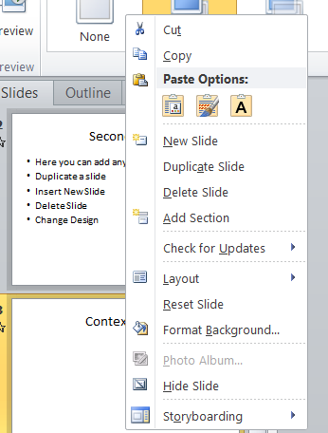
Context Menu
Right mouse click on a slide
New Slide
Duplicate
Delete
Layout
Moving Slides

Slide 3
Layout Sample
Column 1
Column 2
Item 1
Item 2
Item 3
Item 4
Item 5
Item 6
Item 7
Item 8
Item 9
Item 10

Slide 4
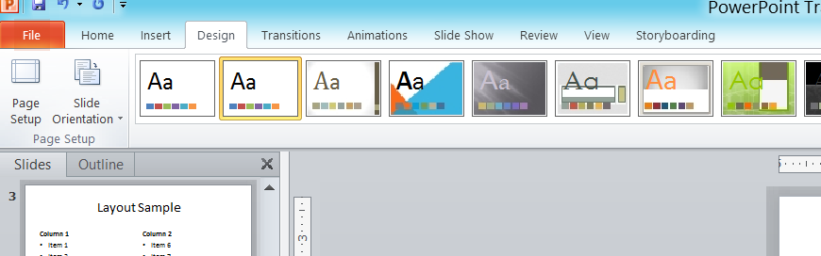
Design

Slide 5
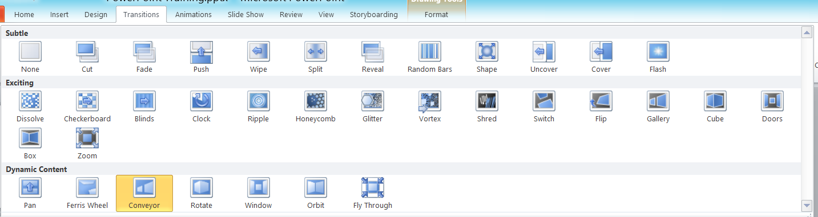
Transitions Tab
Go to Transitions Tab
Click on various Transitions to see the effect

Slide 6
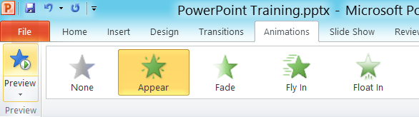
Entrance Animations
Transitions for different items
2nd item
3rd item
4th item
This is done by Animation

Slide 7
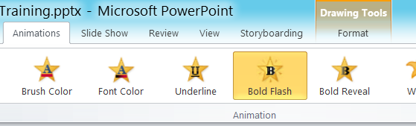
Emphasis Animations
Transitions for different items
2nd item
3rd item
4th item
This is done by Animation

Slide 8
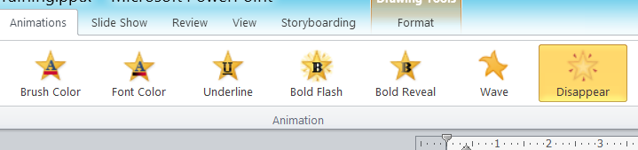
Exit Animations
Transitions for different items
2nd item
3rd item
4th item
This is done by Animation

Slide 9
Motion Animations
Transitions for different items
2nd item
3rd item
4th item

Slide 10
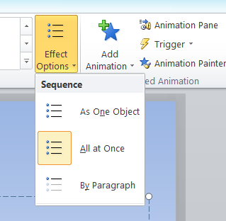
Sequence of Animations
Transitions for different items
2nd item
3rd item
4th item
This is done by Animation

Slide 11
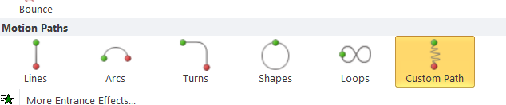
Custom Motion Animations
Transitions for different items
2nd item
3rd item
4th item
This is done by Animation

Slide 12
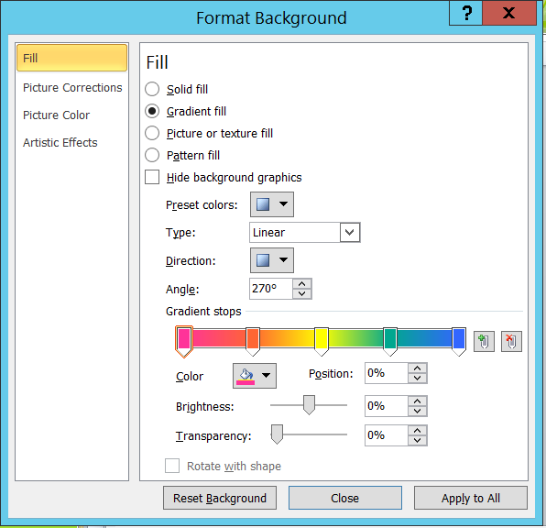
Context menu - Background
Right mouse click on slide

Slide 13
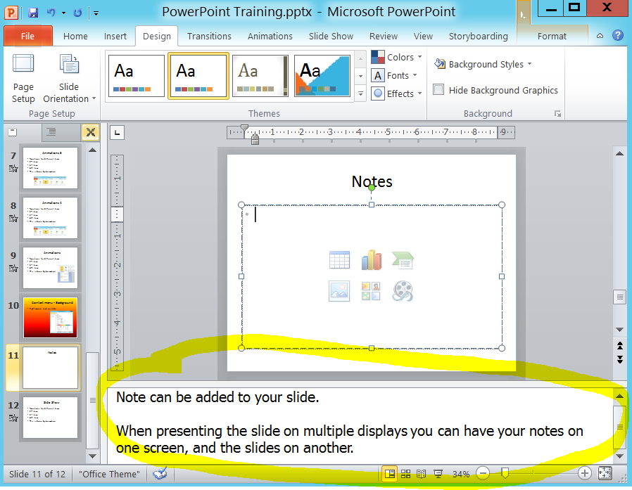
Notes
Notes:
Note can be added to your slide.
When presenting the slide on multiple displays you can have your notes on one screen, and the slides on another.

Slide 14
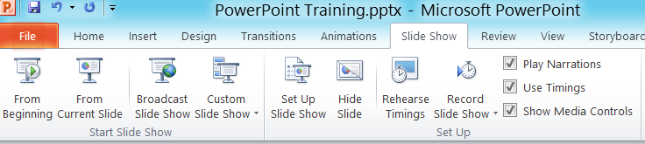
Slide Show
F5 to start a slideshow
Use arrow keys to go back and forward
Escape key to leave slideshow
Rehearse Timings

Slide 15
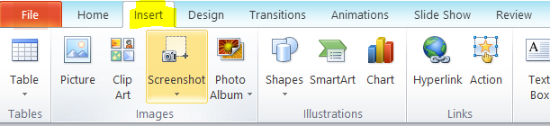

Image, Text, Excel
Column 1 | Column 2 | Column 3 | Column 2
2 | 3 | 67 | 55
4 | 4 | 5 | 7
3 | 45 | 45 | 32
2 | 2 | 4 | 2
6 | 5 | 7 | 9
5 | 6 | 6 | 7
This is a test of WordArt

Slide 16
Charts

Slide 17
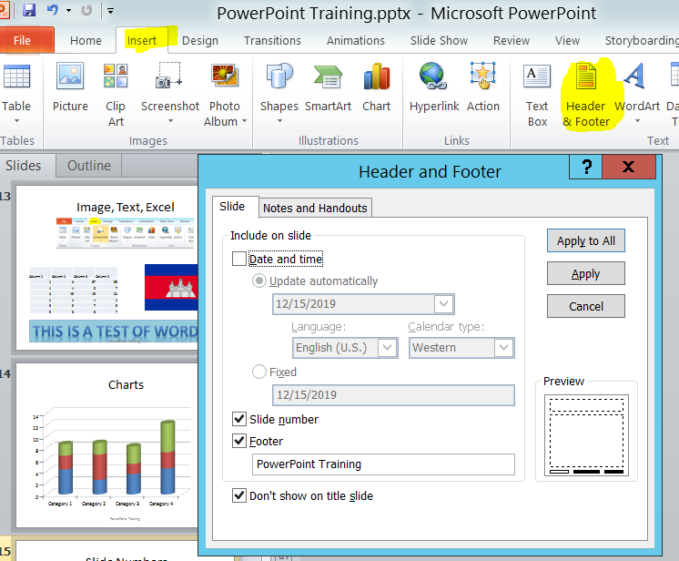
Footers and Slide Numbers

